Slide 1
A Study on Incorporating Privacy and Security Practices in the Development of Software.
Presenter-Sampath Yelchuri
Notes:
Good evening everyone:
My name is Sampath and today I‘m here to present my research which is a study of incorporating Privacy and security practices in the development of software.

Slide 2

Outline
What is SDLC?
Introduction.
Background and Motivation.
Approach of the Research.
Research Questions.
Observations and Analysis.
Security Metrics for Modern SDLCs.
Conclusion.
Future Work.
Notes:
So, today we will discuss the following contents:
read the slide(2)

Slide 3
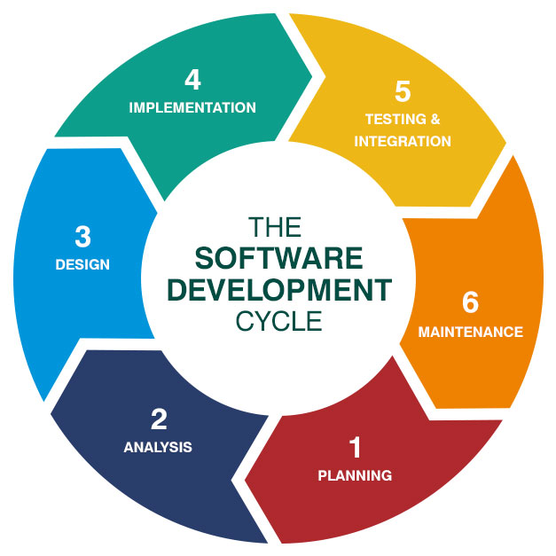
What is SDLC?
“ The term Software Development Life-Cycle is defined as the step by step process of developing or building a software product or system by following certain phases [1].”
Notes:
Read the slide-3
As question that:
What is a Software Development Lifecycle?

Slide 4
Different Types SDLC’s?
These are some of the basic and most used Software Development Life-Cycles based on the size of the project.
Lean
Agile
Waterfall
Spiral
Iterative
DevOps
Notes:
Read the slide-4
Waterfall Model: This is a basic and the oldest model which is widely used model in the 20th century. This model is a structured model which includes 7 phases throughout the lifecycle.
Spiral Model: This model is known as the flexible model which is used for the large-scale projects in the organizations

Slide 5
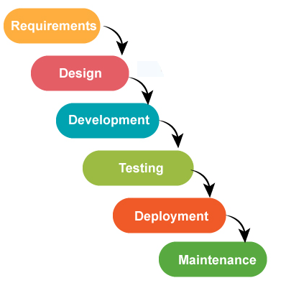
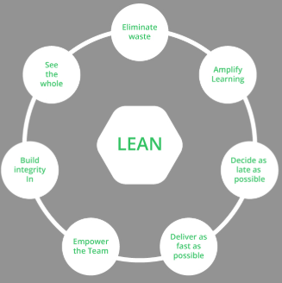
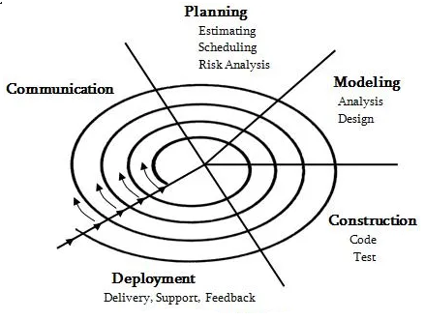
Waterfall
Spiral
Lean
Notes:
Read the slide-5
Waterfall Model: This is a basic and the oldest model which is widely used model in the 20th century. This model is a structured model which includes 7 phases throughout the lifecycle.
Spiral Model: This model is known as the flexible model which is used for the large-scale projects in the organizations.
Lean Model: This model is a special kind of SDLC which keeps the software teams to stay focused instead of going out of scope.

Slide 6

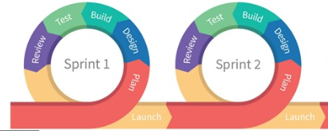
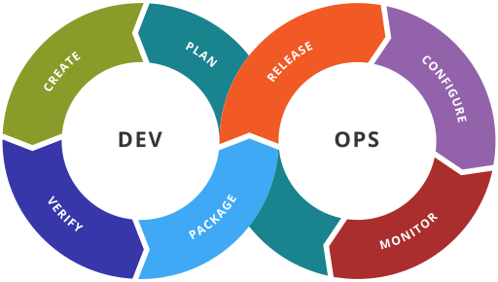
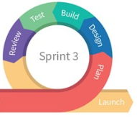
Agile
DevOps
Notes:
Read the slide-6
Agile Model:
DevOps Model:

Slide 7


Introduction
Traditionally, providing security to several software applications or systems is done during the final phases of Software Development Life-Cycles (SDLC’s).
But, many software attacks during the recent years have shown that this approach is no more suitable for developing applications in the current world of internet.

Slide 8
Introduction (Cont.)
Many researches have proved that Involving, Implementing and Embedding privacy and security practices into the modern application development lifecycles could show improved results in terms of securing the software product right from the starting phase of the development.

Slide 9
Background and Motivation
Over the years, we have seen many software’s getting failed due to many vulnerabilities.
Attacker’s try to exploit these vulnerabilities to gain access over the private data of the user over the network.

Slide 10
Background and Motivation (Cont.)
Providing privacy and security to the software system at the final phase of the development as a patch work does not meet the requirements of the business and customers.
So, instead of building the applications in a traditional approach, we can involve various security aspects into the SDLCs to maintain proper security and privacy for the system.

Slide 11
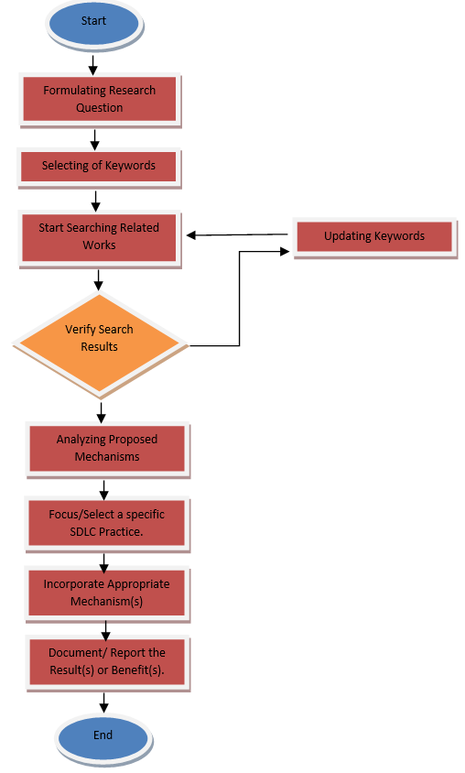
Approach of the Research
STEPS | OPERATIONS
Step-1 | Formulate Research Questions
Step-2 | Search for Results using Keywords
Step-3 | Analyze Proposed Mechanisms
Step-4 | Focus on Agile SDLC
Step-5 | Incorporate Appropriate Mechanism
Step-6 | Document or Report

Slide 12

Research Questions
Research Question 1:
“ What kind of strategies are used to incorporate security aspects into the Agile SDLC?”
Research Question 2:
“How do we define or build the security metrics for modern SDLCs like Agile?”

Slide 13

Miss Conceptions
Following are some of the misconception:
Ignoring and adding security as a patch work is not same as handling security.
Developer’s or Engineer's often fail to design security in today’s world of Internet.
Why do we provide security knowing that we cannot build 100% secured one?
Notes:
Now let us investigate some of the mis-conceptions.

Slide 14
Observations and Analysis
Idea
Gated Security Approach:
This is a traditional approach that is applied on the novel Software Development Life-Cycle.
This approach deals with inserting security practices between the phases of Software Development Life_-Cycles (SDLC’s).
Initial Risk Assessment
Design
Design Review
Code
Code and Implementation Review
Test
Penetration Testing
Deploy
Notes:
Gated Security approach in traditional SDLCs

Slide 15
Observations and Analysis (Cont.)
After looking at various research proposals and methodologies, we have come up the following steps that an organization can adapt for a better and secured software:
Knowing Developer Technology Stack
Add, Adapt and Abandon Policies
Communication
Notes:
Gated Security approach in Agile by following the 3 practices.

Slide 16
Security Metrics for Modern SDLCs
A ‘Security Metric’ is generally defined a measure that relatively quantifies the amount of security provided [5].
Formal Security Metric Description
Name | Description
Metric | Name of the Metric
Metric Description | Description of what is measured.
Procedure | How is it measured
Threshold | How do are thresholds evaluated
Target Value | Best possible measure.
Current Value | Present measure.
Units | Units of Measurement
Notes:
Security Metrics.

Slide 17
Security Metrics for Modern SDLCs (Cont.)
Discover and Define
Gather and Populate Dashboards
Communication Plan
Notes:
Building Security Metrics.

Slide 18
Conclusion
By looking at of these, we can really look at building a Secured Software Development Life-Cycle(s) (SecSDLCs) and make also build Security Metrics that represents the measure of security for various organizations.

Slide 19

Future Work
Coming down the line, we will look at the other Software Development Life-Cycles like DevOps and other popular practices which would be a beneficiary for software building companies.

Slide 20
References
“What is the Software Development Life Cycle (SDLC)? - Definition from Techopedia,” Techopedia.com. [Online]. Available: https://www.techopedia.com/definition/22193/software-development-life-cycle-sdlc. [Accessed: 20-Nov-2019].
M. Kumar Sharma, A study of SDLC to develop well engineered software, International Journal of Advanced Research in Computer Science, vol. 8, no. 3, pp. 14, 2107.
N. S. A. Karim, A. Albuolayan, T. Saba, and A. Rehman, The practice of secure software development in SDLC: an investigation through existing model and a case study, Security and Communication Networks, vol. 9, no. 18, pp. 53335345, 2016.
C. Muniraman, M. Damodaran, ”A Practical Approach to Include Security in Software Development”, Issues in Information Systems, vol. 8, no. 2, pp. 193-199, 2007.
S. Vonnegut, “Application Security Metrics: Where (And Why) To Begin?,” Checkmarx, 16-Dec-2015. [Online]. Available: https://www.checkmarx.com/2015/05/15/application-security-metrics-where-and-why-to-begin/. [Accessed: 20-Nov-2019].

Slide 21
Questions ?

